Slide 1

Database Basics
SoftUni Team
Technical Trainers
Software University
https://softuni.org

Slide 2
Table of Contents
Data Management
Structured Query Language
Difference between SQL and NoSQL
Data Types
2
Notes:
2

Slide 3
Have a Question?
sli.do
#python-web
Notes:
3

Slide 4

Data Management
When Do We Need a Database?

Slide 5
Storage vs. Management
SALES RECEIPT
00315 – 07/16/2016
David Rivers
Oil Pump (OP147-0623)
1 x 69.90
Date: 07/16/2016
Order#:[00315]
Customer: David Rivers
Product: Oil Pump
S/N: OP147-0623
Unit Price: 69.90
Qty: 1
Total: 69.90

Slide 6
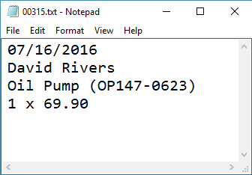
Storage vs. Management (2)
Order# | Date | Customer | Product | S/N | Qty
00315 | 07/16/2016 | David Rivers | Oil Pump | OP147-063 | 1

Slide 7
Databases
A database is an organized collection of related information
It imposes rules on the contained data
Access to data is usually provided by a "system" (DBMS) database management
Relational storage first proposed by Edgar Codd in 1970

Slide 8
RDBMS
Relational Data Base Management System
Database management
It parses requests from the user and takes the appropriate action
The user doesn't have direct access to the stored data
Data is presented by relations – collection of tables related by common fields
PostgreSQL, SQLite, Oracle and MySQL

Slide 9

Structured Query Language

Slide 10
Structured Query Language
Programming language designed for managing data in a relational database
Developed at IBM in the early 1970s
To communicate with the Engine, we use SQL

Slide 11
Structured Query Language (2)
Subdivided into several language elements
Queries
Clauses
Expressions
Predicates
Statements
Update clause
Expression
UPDATE employees
SET salary = salary * 0.1
WHERE job_title = "Cashier";
Statement
Predicate

Slide 12
Structured Query Language (3)
Logically divided in four sections
Data Definition – describe the structure of our data
Data Manipulation – store and retrieve data
Data Control – define who can access the data
Transaction Control – bundle operations and allow rollback

Slide 13

SQL vs NoSQL

Slide 14
SQL vs NoSQL
SQL:
RDBMS
Predefined Schema
Suited for complex queries
Vertically scalable
NoSQL:
Non-relational database system
Dynamic Schema
Suited for hierarchical data storage
Horizontally scalable

Slide 15
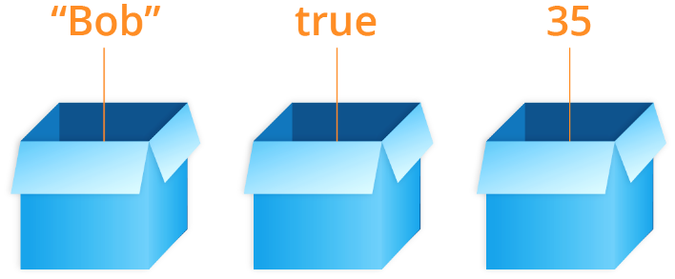
Data Types

Slide 16
Common Data Types:
INT - stores whole numbers
VARCHAR / NVARCHAR - variable length character
DECIMAL / FLOAT - stores decimal values
DATETIME - store the date and time
Example: 1972-11-05 00:00:00.000
BIT – Boolean data type

Slide 17



Table Relations
Relational Database Model in Action

Slide 18
Relationships
Relationships between tables are based on interconnections: PRIMARY KEY / FOREIGN KEY
Primary key
Foreign key
towns
Primary key
id | name | country_id
1 | Sofia | 1
2 | Varna | 1
3 | Munich | 2
4 | Berlin | 2
5 | Moscow | 3
countries
id | name
1 | Bulgaria
2 | Germany
3 | Russia
Relationships

Slide 19
Relationships (2)
The foreign key is an identifier of a record located in another table (usually its primary key)
By using relationships, we avoid repeating data in the database
Relationships have multiplicity:
One-to-many – e.g., mountains / peaks
Many-to-many – e.g., student / course
One-to-one – e.g., example driver / car

Slide 20
One-to-One
Primary key
Primary key
Foreign key
cars
drivers
car_id | driver_id
1 | 166
2 | 102
driver_id | driver_name
166 | …
102 | …
Relation
Notes:
In One-to-One relationship each row of table Cars is related to exactly zero or one row in table Drivers. In table Cars.DriverID is a foreign key which means that there will be a relation to another table – Drivers in the case. Table Drivers has a column DriverID as well which is a primary key. The relation is always between a foreign key and a primary key. It means that all values in Cars.DriverID should be present in Drivers. DriverID except NULL. Cars.DriverID can be NULL if it is not stated otherwise.

Slide 21
One-to-Many/Many-to-One
Primary key
Primary key
Foreign key
Mountains
Peaks
mountain_id | name
1 | Causasus
peak_id | mountain_id
61 | 1
66 | 1
Relation
Notes:
One-to-Many relationship means that each row from a table is related zero, one or many rows in the referent table. In the case above, each mountain can have 0, 1 or many peaks. The example shows that the mountain Caucasus has two peaks - One-to-Many. If you look the other way around many peaks has exactly one mountain – Many-to-One.

Slide 22
Many-to-Many
Primary key
Primary key
employees
projects
employee_id | name
1 | …
40 | …
project_id | name
4 | …
24 | …
Mapping table
employees_projects
employee_id | project_id
1 | 4
40 | 24
Notes:
Many-to-Many relationship relates many rows from a table to many rows in another table. For example. Employee.EmployeeID has many projects. Many projects are assigned to many employees which is the other way around. Usually we have a mapping table that takes care of the relations.

Slide 23
Junction Tables
students
classrooms
student_id | name
1 | Peter
2 | George
classroom_id | number
1 | 10
2 | 20
student_classroom
student_id | classroom_id | pk_student_classroom
1 | 1 | 11
2 | 2 | 22
1 | 2 | 12
Combination of the 2 ids

Slide 24

Summary
…
…
…
What is a Database?
RDBMS
SQL
SQL vs NoSQL
Data Types
Table Relations

Slide 25
Questions?
Notes:
25

Slide 26














SoftUni Diamond Partners

Slide 27

Educational Partners

Slide 28
Trainings @ Software University (SoftUni)
Software University – High-Quality Education, Profession and Job for Software Developers
softuni.bg, softuni.org
Software University Foundation
softuni.foundation
Software University @ Facebook
facebook.com/SoftwareUniversity
Software University Forums
forum.softuni.bg
Notes:
28

Slide 29

License
This course (slides, examples, demos, exercises, homework, documents, videos and other assets) is copyrighted content
Unauthorized copy, reproduction or use is illegal
© SoftUni – https://softuni.org
© Software University – https://softuni.bg
Notes:
29

